Slide 1







Slide 2


Basic Ideas
Target Users : University ( staff, university, others) and municipality (authorities, citizens) etc.
Goal : Help Community members to interact , communicate, share ideas and reward them.
UX goal : Make community members to communicate easily and effectively.

Slide 3
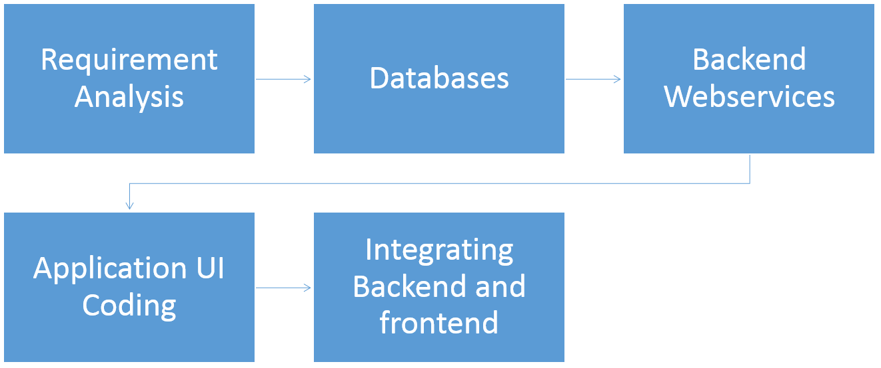
Implementation Process

Slide 4
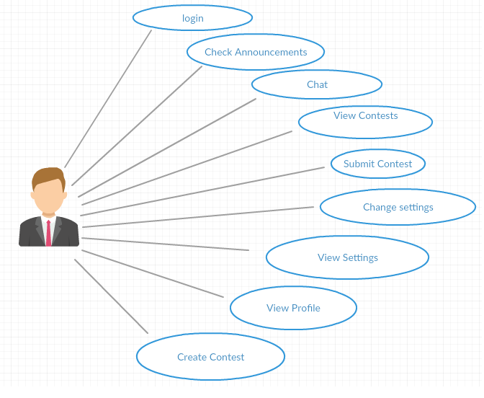
Bullething Use Case

Slide 5

Collaboration Diagram
Announcements
vAncnmnts()
View Announcements
Announcements()
Chat
Chat()
Submit Contest
sContest()
Login
Contests()
Contests
aContest()
Add Contest
Settings()
Profile()
Settings
uSettings()
Update Settings
Profile

Slide 6
Implemented Features
Community User login
Community User announcements
Community Contest
Community User Settings
Community User Profile

Slide 7
Missing Features
Google Cloud messaging Integration
Application feedback

Slide 8
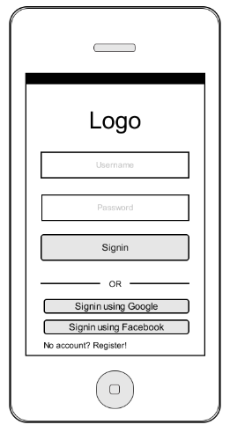


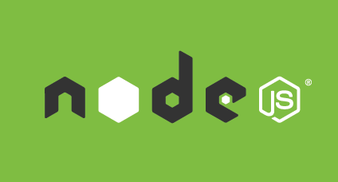


Changed Features

Slide 9


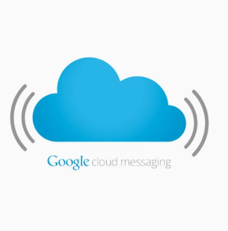


Key Technologies
Android (Lollipop)
Core Java
XML Layouts for design
Google Cloud Messaging
Node JS
PostgreSQL

Slide 10
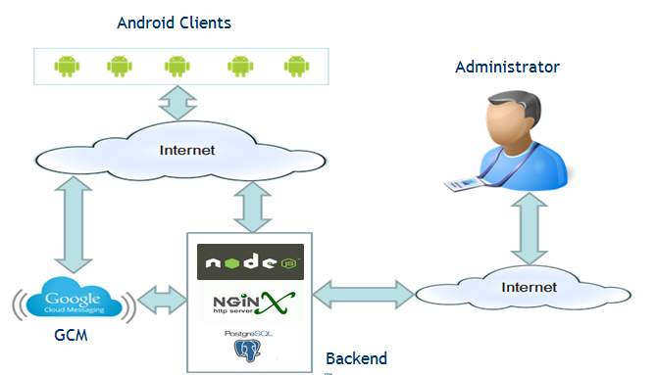
System Architecture

Slide 11
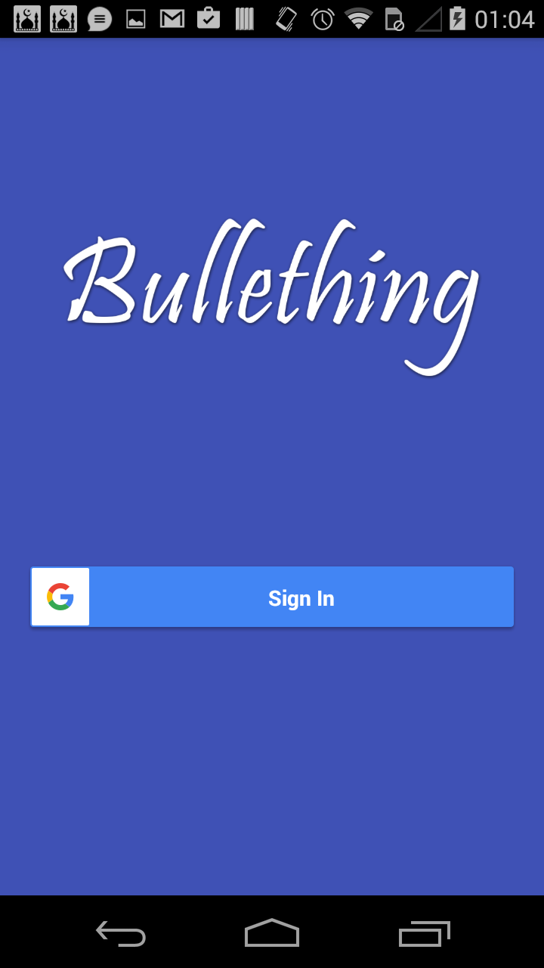
Application Front Page
Figure 1: Community Login

Slide 12
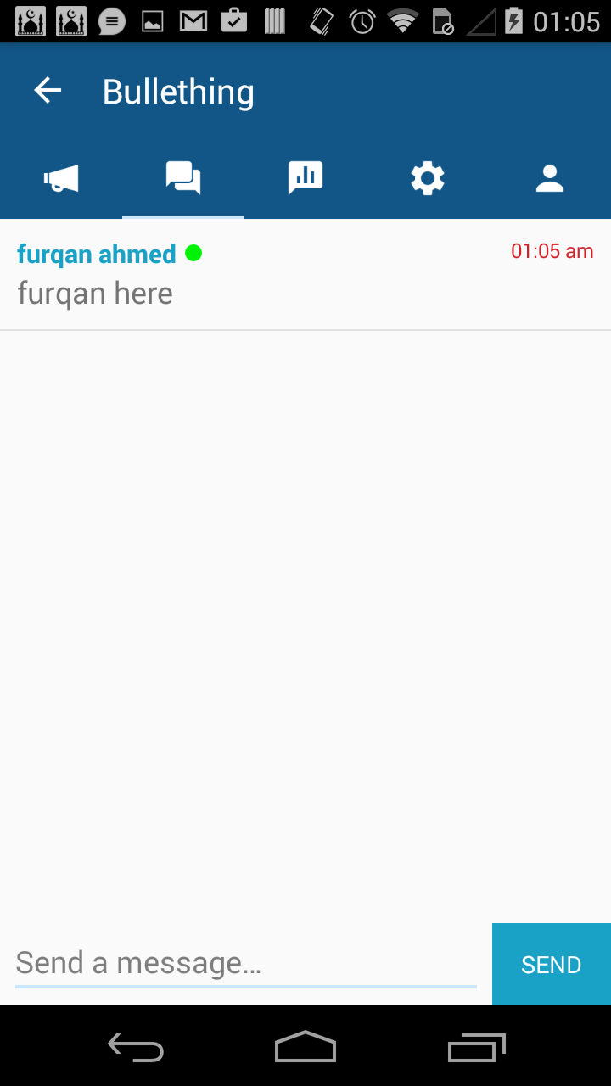
Chat
Figure 2: Community Chat.

Slide 13
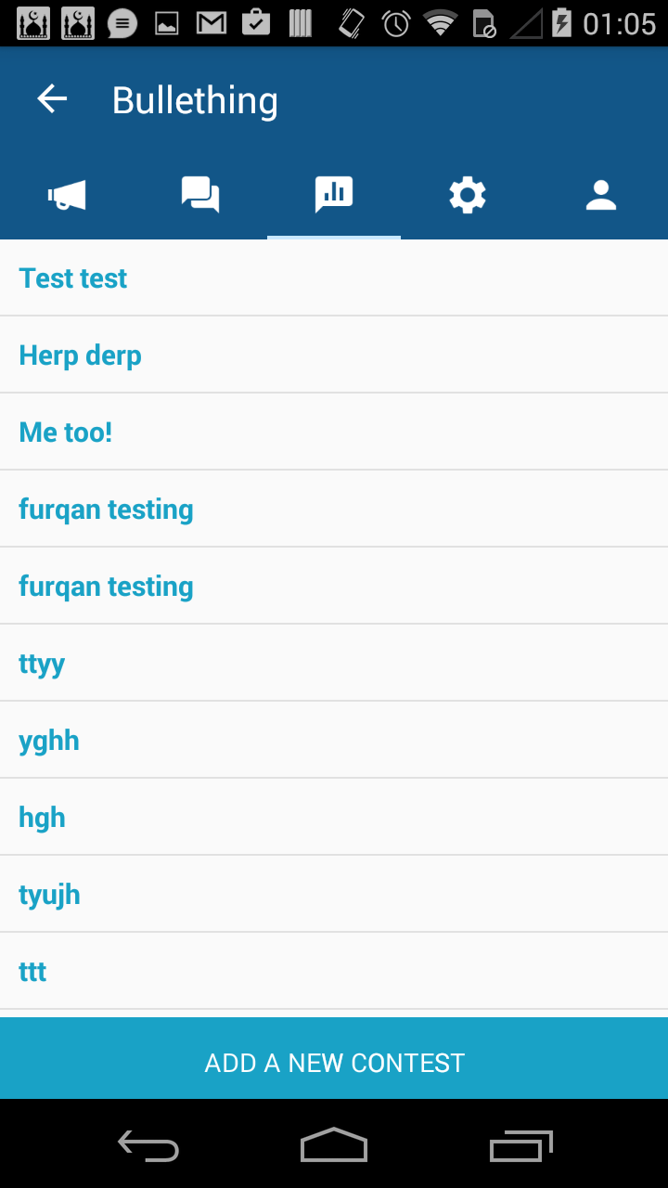
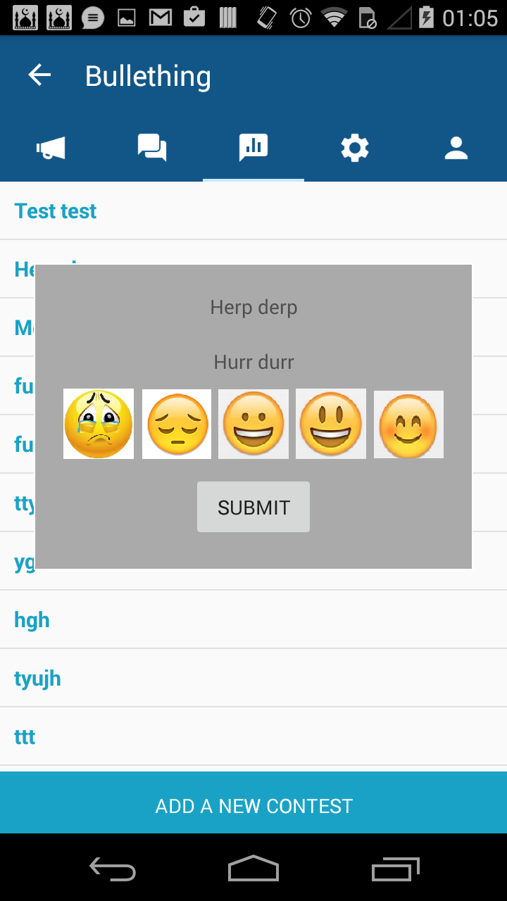
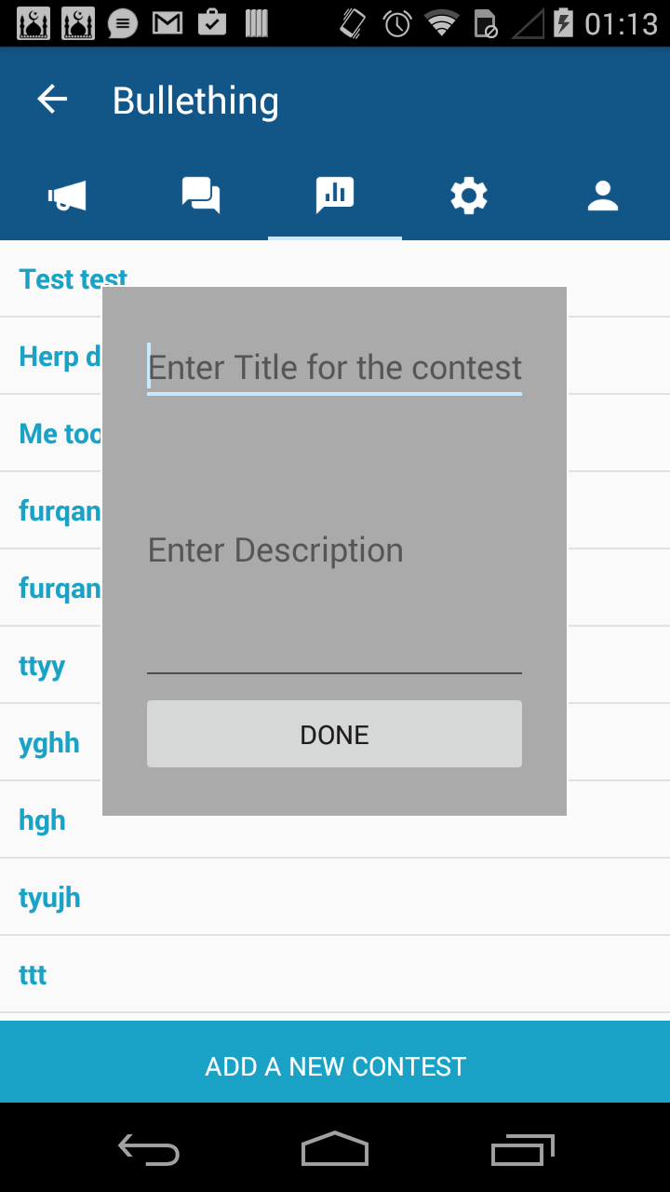
Contest
Figure 3: View/submit/Browse Community Contest.

Slide 14
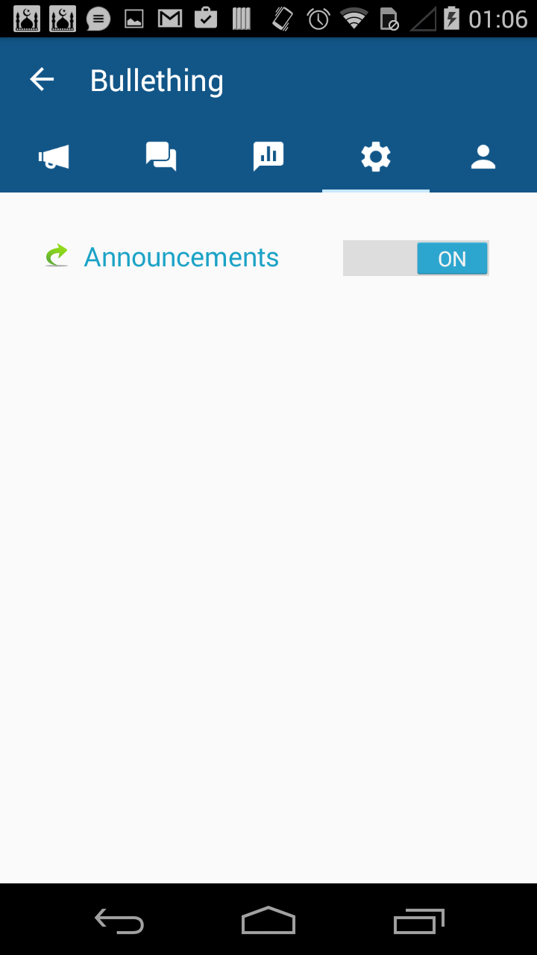
Settings Screen
Figure 4: Community settings.

Slide 15
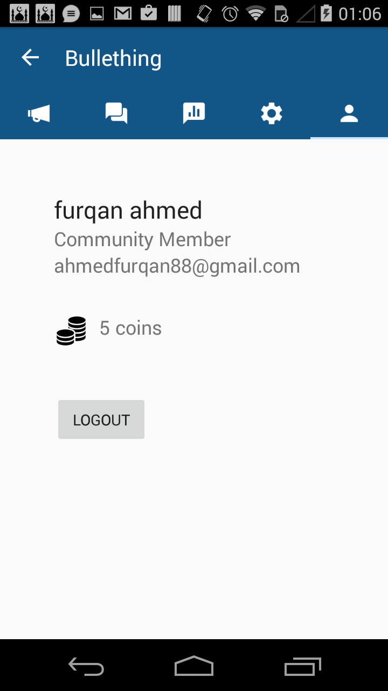
Profile Screen
Figure 5: User Profile

Slide 16
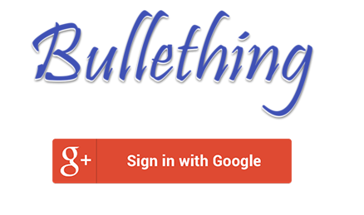
Admin Login(Web)

Slide 17
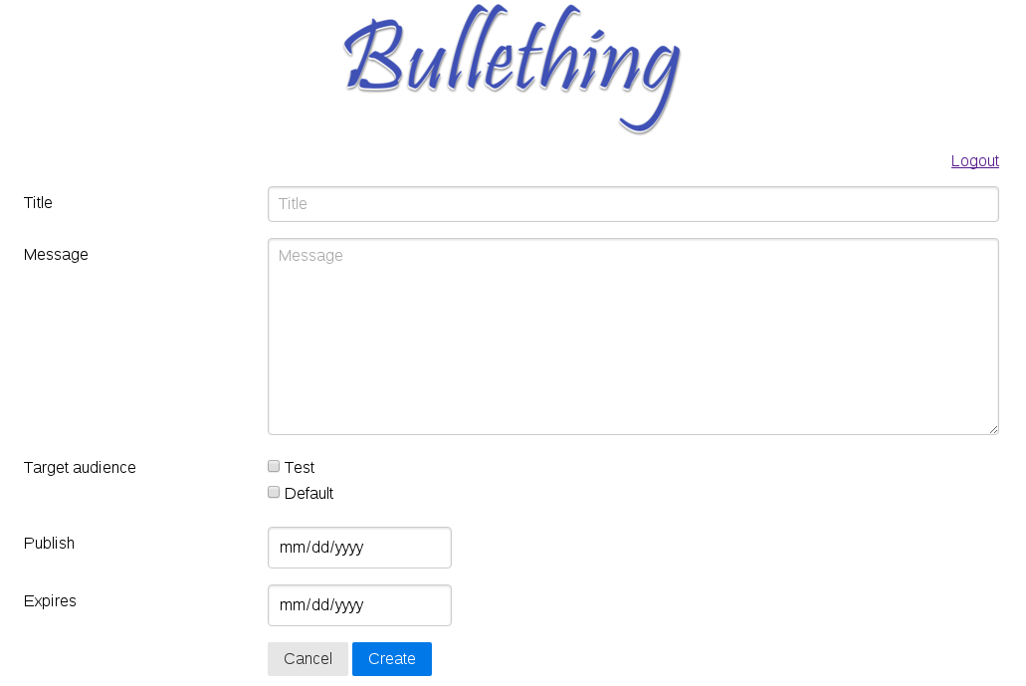
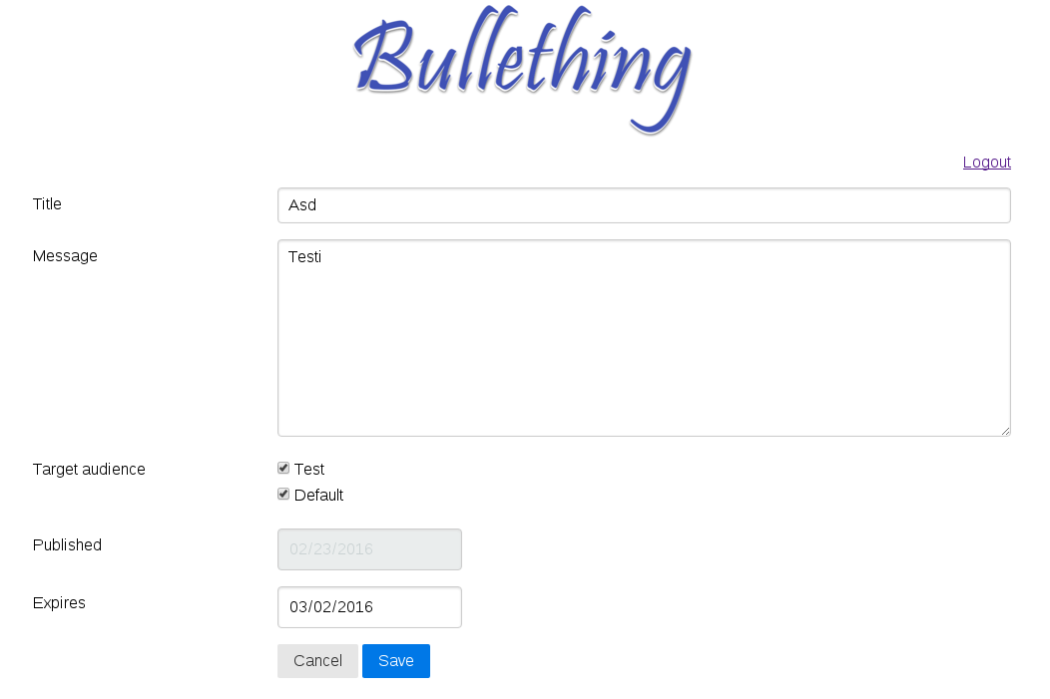
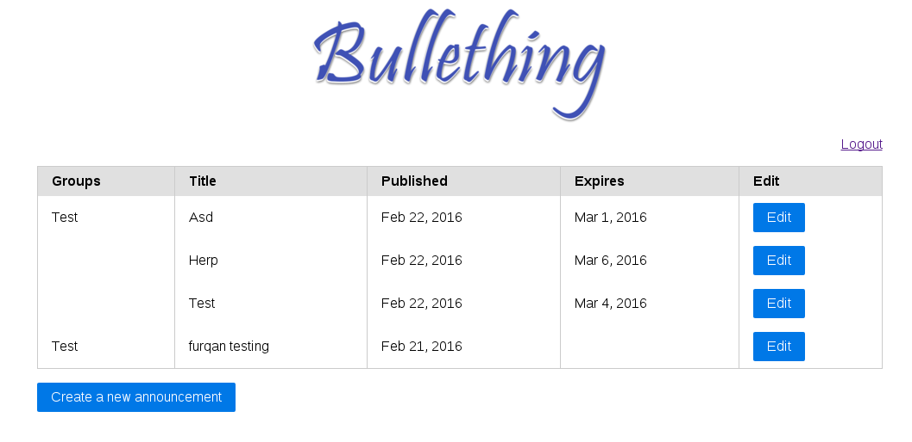
Add/Edit/List Announcements

Slide 18
Security & Privacy
Google OAuth
HTTPS Requests
Secure Server
PubNub – AES Encryption
Ident Authentication

Slide 19
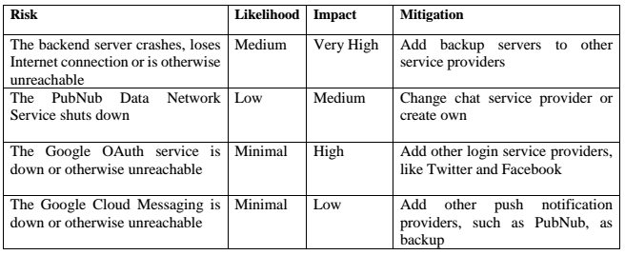
Risk Assessment

Slide 20
Contributions
Furqan Ahmed (61h, 35%) :
Web backend, Android Development and organization.
Mikko Korhonen (60h, 35%):
Web Frontend, Android Development, Production Server Administration.
Oula Kuuva (55h, 30%):
Web backend, Android Development and Documentation.

Slide 21
Appreciate Your Time
Questions and Comments?

